Slide 1
Correlated vs. Noncorrelated Subqueries
Noncorrelated subqueries:
Do not depend on data from the outer query
Execute once for the entire outer query
Correlated subqueries:
Make use of data from the outer query
Execute once for each row of the outer query
Can use the EXISTS | NOT EXISTS operator

Slide 2
Correlated subqueries
A Correlated subquery uses a value from the main query as part of the inner query
Data from each row in the main query is “passed” to the subquery for processing
Typically a processing-intensive operation
Subquery must be re-run with new value(s) for each row

Slide 3
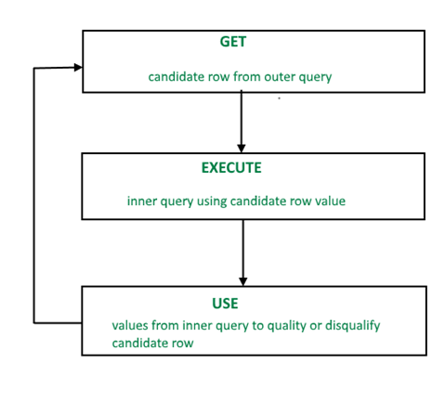
Correlated subquery

Slide 4
When Should You Use a SQL Correlated Subquery?
It is used whenever a subquery must return a different result or set of results for each candidate row considered by the main query.
This is particularly true when asking negative data questions.
Negative data questions arise when we search for records that don’t satisfy a particular condition.
An example of a simple negative data question is: “Obtain the names of all movies not produced by Steven Spielberg.”

Slide 5
CORRELATED SUBQUERY
SELECT column_name(s) FROM table1 WHERE column_name operator (SELECT column_name FROM table2 WHERE expr1=table2.expr2);
You can also use the ANY and ALL operator in a correlated subquery.

Slide 6
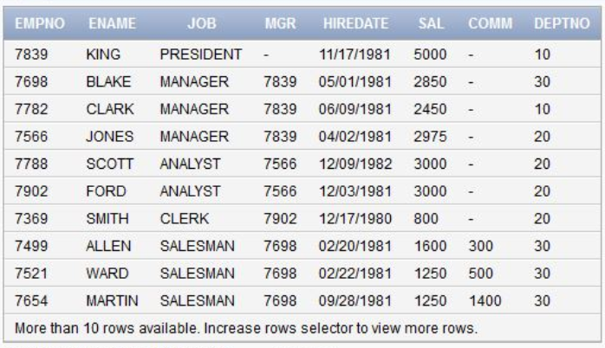
Find second highest salary from the employee list
SELECT e.Name,e.Salary
FROM Employee e
WHERE 1 = ( SELECT COUNT(Salary)
FROM Employee p
WHERE p.salary > e.salary)

Slide 7
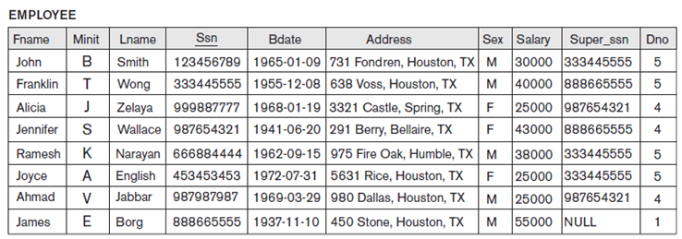
Find all the employees who earn more than the average salary in their department.
SELECT Lname, Salary, Dno
FROM EMPLOYEE outer
WHERE Salary >
(SELECT AVG(Salary)
FROM EMPLOYEE
WHERE Dno = outer.Dno);

Slide 8

Select an employee name and city whose income is higher than the average income of all employees from that city.

Slide 9
EXISTS / NOT EXISTS
If the subquery returns at least one row, the EXISTS operator returns true, otherwise, it returns false.
In addition, the EXISTS operator terminates further processing immediately once it finds a matching row, which can help improve the performance of the query.
The NOT operator negates the EXISTS operator. In other words, the NOT EXISTS returns true if the subquery returns no row, otherwise it returns false.
Note that you can use SELECT *, SELECT column, SELECT a_constant, or anything in the subquery. The results are the same because MySQL ignores the select list appeared in the SELECT clause.

Slide 10
EXISTS / NOT EXISTS
The EXISTS operator is a Boolean operator that returns either true or false.
The EXISTS operator is often used to test for the existence of rows returned by the subquery.
SELECT select_list
FROM a_table
WHERE [NOT] EXISTS(subquery);

Slide 11
Find employees who have at least one person reporting to them.
SELECT Ssn, Lname, Dno
FROM employee outer
WHERE EXISTS ( SELECT ’X’
FROM employee
WHERE Super_ssn = outer.Ssn);

Slide 12
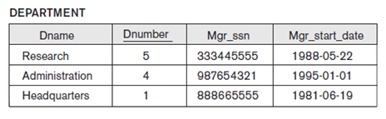
Find all departments that do not have any employees.
SELECT Dnumber, Dname
FROM department d
WHERE NOT EXISTS (SELECT ’X’
FROM employee
WHERE Dno = d.Dnumber);

Slide 13
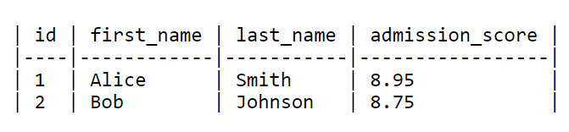


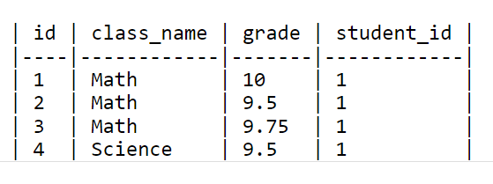
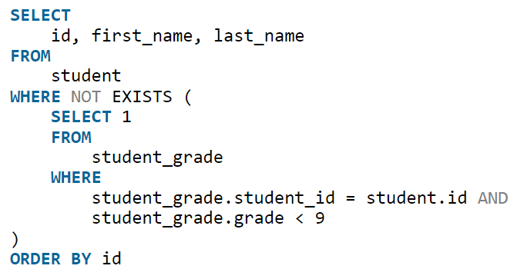
Find all the student records that have no associated student_grade with a value lower than 9

Slide 14
REFERENCES
https://javarevisited.blogspot.com/2012/07/subquery-example-in-sql-correlated-vs.html#ixzz6FhwRaPs2
https://www.geeksengine.com/database/subquery/return-single-value.php
https://www.geeksforgeeks.org/sql-exists/

